Slide 1
Design Concepts
Management of Software Systems

Slide 2
Design
Mitch Kaper, the Creator of Lotus123, presented a software design manifesto, in Dr. Dobb’s Journal. He said
Good software design should exhibit
Firmness: A program should not have any bugs that inhibit its function
Commodity: A program should be suitable for the purposes for which it was intended
Delight: The experience of using the program should be pleasurable one

Slide 3
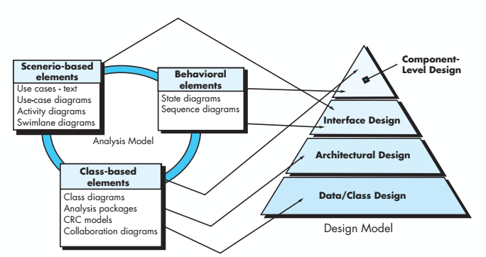
Analysis model -> Design model

Slide 4
Design and Quality
The design must implement all of the explicit requirements contained in the analysis model, and it must accommodate all of the implicit requirements desired by the customer
The design must be a readable, understandable guide, for those who generate code and for those who test and subsequently support the software
The design should provide a complete picture of the software, addressing the data, functional and the behavioral domains from an implemenatation perspective

Slide 5
Quality guidelines
A design should exhibit an architecture that
thereby facilitating implementation and testing.
(a) has been created using recognizable architectural styles or patterns,
(b) is composed of components that exhibit good design characteristics and
(c) can be implemented in an evolutionary fashion

Slide 6
Quality guidelines
.A design should be modular; that is, the software should be logicallypartitioned into elements or subsystems.
A design should contain distinct representations of data, architecture, interfaces, and components.
A design should lead to data structures that are appropriate for the classes to be implemented and are drawn from recognizable data patterns.
A design should lead to components that exhibit independent functional characteristics.
A design should lead to interfaces that reduce the complexity of connection sbetween components and with the external environment.
A design should be derived using a repeatable method that is driven by information obtained during software requirements analysis.
A design should be represented using a notation that effectively communicates its meaning.

Slide 7
Quality attributes
Functionality
Assessed by evaluating feature set and capability of the program, generality of the functions delivered, security of the overall system
Usability
Assess by human factors, overall aesthetics, consistency, and documentation
Reliability
Evaluated by measuring the frequency and severity of failure, and predictability of the program
Performance
Measured by processing speed, response time, resources, throughput, and efficiency
Supportability
Ability to extend the program adaptability, serviceability

Slide 8
Design principles
The design process should not suffer from ”tunnel vision”
The design should be traceable to the analysis model
The design should not reinvent the wheel
The design should “minimize the intellectual distance” between the software and the problem as it exist in the real world
The design should exhibit uniformity and integration

Slide 9
Design principles
The design should be structured to accommodate change
The design should be structured to degrade gently, even when aberrant data , events, or operating conditions are encountered
Design is not coding, coding is not design
The design should be assessed for quality as it is being created, not after the fact
The design should be reviewed to minimize conceptual (semantic) errors

Slide 10
Design concepts
Abstraction
Architecture
Patterns
Data, procedure, control
The overall structure of the software
“Conveys the essence” of a proven design solution
Separation of concerns
Any complex problem can be more easily handled if it is subdivided into pieces

Slide 11
Design concepts
Modularity
Compartmentalization of data and functions
Hiding
Controlled interfaces
Functional independence
Single minded function and low coupling
Refinement
Elaboration of detail for all abstractions

Slide 12
Design concepts
Aspects
A mechanism for understanding how global requirements affect design
Refactoring
A reorganization technique that simplifies the design
OO design concepts
Design classes
Provide design detail that will enable analysis classes to be implemented

Slide 13
Abstraction
Procedural abstraction
Data abstraction
A sequence of instructions that have a specific and limited function
Eg. Open for a door (a long sequence of procedural steps)
A named collection of data that describes a data object
Eg. Door

Slide 14
Architecture
The overall structure of the software and the ways in which that structure provides conceptual integrity of system
Structural properties
This aspect of the architectural design representation defines the components of a system (eg. Modules, objects, filters) and the manner in which those components are packaged and interact with one another. For example, objects are packaged to encapsulate both data and the processing that manipulates the data and interact via invocation of methods
Extra functional properties
The architectural design description should address how the design architecture achieves requirements for performance
Families of related systems
The architectural design should draw upon repeatable patterns that are commonly encountered in the design of families of similar systems . In essence the design should have the ability to reuse architectural building blocks.

Slide 15
Architecture
Structural models
Framework models
Dynamic models
Process models
Functional models
Represent architecture as an organized collection of program components
Identify repeatable architectural design frameworks that are encountered in the similar types of applications
Address the behavioral aspects of the program architecture
Focus on the design of the business or technical process that the system must accommodate
Used to represent the functional hierarchy of a system

Slide 16
Patterns Design pattern template
Pattern name
Describes the essence of the pattern in a short but expressive name
Intent
Describes the pattern and what it does
Also-known-as
Lists any synonyms for the pattern
Motivation
Provides an example of the problem
Applicability
Notes specific design situations in which the pattern is applicable

Slide 17
Patterns Design pattern template
Structure
Describe the classes that are required to implement the pattern
Participants
Describes the responsibilities of the classes that are required to implement the pattern
Collaborations
Describes how the participants collaborate to carry out their responsibilities
Consequences
Describes the design forces that affect the pattern and the potential trade offs that must be considered when the pattern is implemented
Related patterns
Cross-reference related design patterns

Slide 18
Separation of concerns
Any complex problem can be more easily handled if it is subdivided into pieces that can easily solved and are optimized independently
A concern is a feature or behavior that is specified as part of the requirements model for the software
By separating concerns into smaller and therefore more manageable pieces a problem takes less effort and time to solve.

Slide 19
Modularity
Modularity is the single attribute of the software that allows a program to be intellectually manageable
Monolithic software (ie. A large program composed of a single module ) cannot easily be grasped by a software engineer
The number of control paths, span of reference, number of variables, and overall complexity would make understanding close to impossible
In almost all instances you should make the design into many modules, hoping to make understanding easier and as a consequence , reduce the cost required to build the software

Slide 20
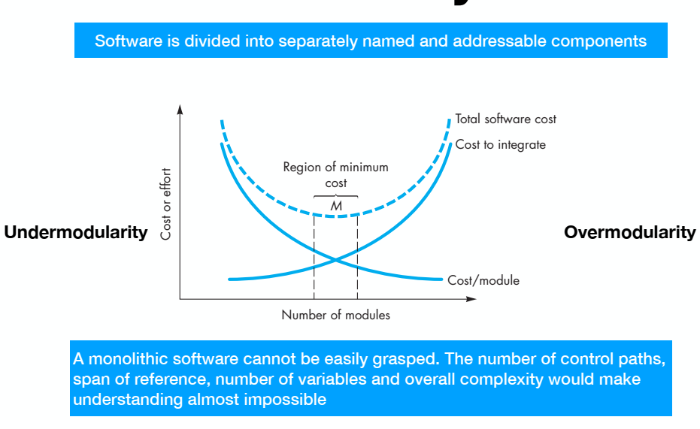
Modularity: Trade-Offs What is the right number of modules for a specific software design ?

Slide 21
Information hiding
Modules are specified and designed so that information (algorithm and data) contained within a module is inaccessible to other modules
Useful
When modifications are required during testing and maintenance
Inadvertent errors introduced during modifications are less likely to propagate to other locations

Slide 22
Why Information hiding ?
Reduces the likelihood of “side effects”
Limits the global impact of local design decisions
Emphasizes communication through controlled interfaces
Discourages the use of global data
Leads to encapsulation – an attribute of high quality design
Results in higher quality software

Slide 23
Stepwise refinement
Open
Walk to door;
Reach for knob;
Open door;
Walk through;
Close door.
Repeat until door opens
Turn knob clockwise;
If knob doesn’t turn then
Insert in lock
find correct key;
endif
Pull/push door
Move out of way;
End repeat;
take key out;

Slide 24
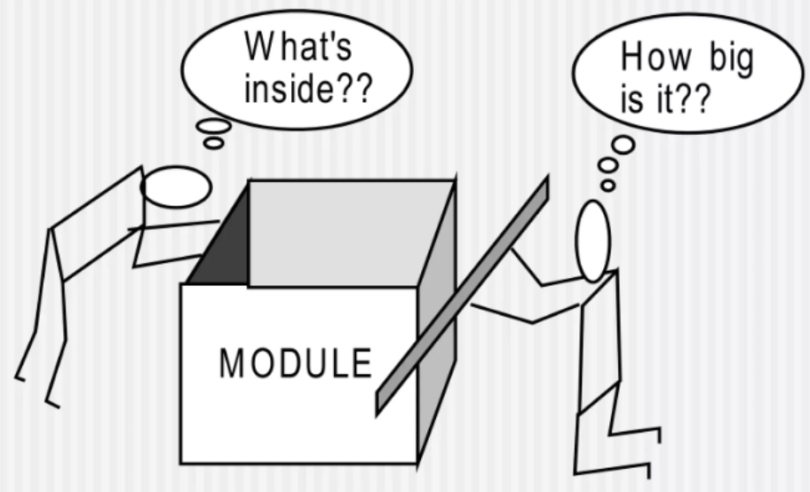
Sizing Modules: Two views

Slide 25
Functional independence
Functional independence is achieved by developing modules with “single mnided” function and an “aversion” to excessive interaction with other modules
COHESION is an indication of the relative functional strength of a module
A cohesive module performs a single task, requiring little interaction with other components in other parts of a program. Stated simply, a cohesive module should (ideally) do just one thing.
COUPLING is an indication of the relative interdependence among modules
Coupling depends on the interface complexity between modules, the point at which entry or reference is made to a module, and what data pass across the interface

Slide 26
Cohesion
A cohesive module performs a single task in a procedure with little interaction with others.
Goal: Achieve high cohesion for modules in a system

Slide 27
Different types of Cohesion
Coincidentally cohesive
A set of tasks related to each other loosely
Logically cohesive
Logical connection among processing elements
Communication cohesion
Data sharing among processing elements
Procedural cohesion
Order among processing elements

Slide 28
Coupling
Goal
Strive for lowest possible coupling among modules
Good coupling
Reduce or avoid change impact and ripple effects
Reduce the cost in program changes, testing, maintenance

Slide 29
Types of Coupling
Data coupling
Parameter passing or data interaction
Control coupling
Share related control logical (for a control data)
Common coupling
Common data sharing
Content coupling
A modules uses data or control information maintained in another module

Slide 30
Refinement
Successively refining levels of procedural detail
A process of elaboration
Begin with a stmt of function
Helps to reveal low-level details as design progress

Slide 31
Aspects
Consider 2 requirements A and B. Requirement A crosscuts requirement B if a software decomposition [refinement] has been chosen in which B cannot be satisfied without taking A into account
An aspect is a representation of a cross cutting concern

Slide 32
Refactoring
Refactoring is the process of changing a software system in such a way that it doe snot alter the external behavior of the code (design) yet improves its internal structure
When software is refactored, the existing design is examined for
Redundancy
Unused design elements
Inefficient or unnecessary algorithms
Poorly constructed or inappropriate data structures
Or any other design failure that can be corrected to yield a better design

Slide 33
OO Design Concepts
Design classes
Entity classes
Boundary classes
Controller classes
Inheritance
All responsibilities of a super class is immediately inherited by all subclasses
Messages
Stimulate some behavior to occur in the receiving object
Polymorphism
A characteristic that greatly reduces the effort required to extend the design

Slide 34
Design Classes
Analysis classes are refined during design to become entity classes
Boundary classes are developed during design to create the interface (e.g. interactive screen or printed reports) that the user sees and interacts with as the software is used
Boundary classes are designed with the responsibility of managing the way entity objects are represented to user
Controller classes are designed to manage
The creation or update of entity objects
The instantiation of boundary objects as they obtain information from entity objects
Complex communication between sets of objects
Validation of data communicated between objects or between the user and the application

Slide 35
Characteristic of good class
Complete and sufficient
Complete encapsulation of all attributes and methods that can reasonably be expected to exist for the class
Primitiveness
Focused on accomplishing one service for the class
High cohesion
A small focused set of responsibilities and single mindedly applied attributes and methods to implement those responsibilities
Low coupling
Classes collaborate with another, and keep to an acceptable minimum

Slide 36
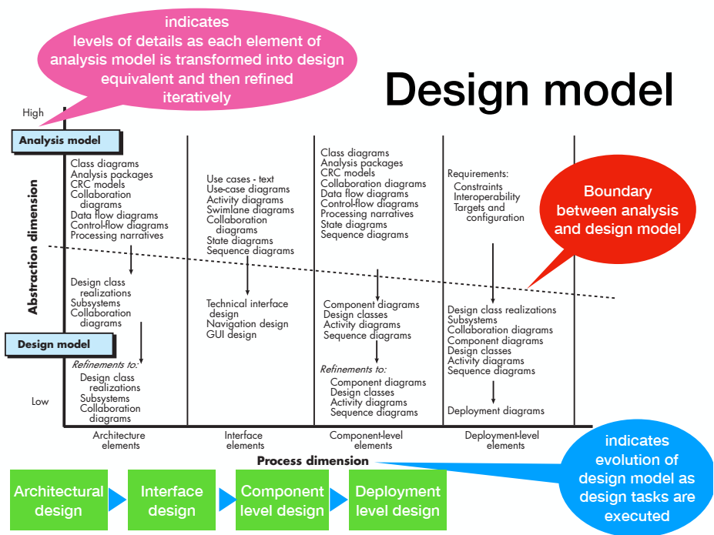

Slide 37
Design model elements
Data design elements
Data model -> data structures
Data model -> database architecture
Architectural design elements
Application domain
Analysis classes, their relationships, collaborations, and behaviors are transformed into design realizations
Patterns and styles
Interface design elements
The user interface
External interfaces to other systems, devices, networks or other producers or consumers of information
Internal interfaces between various design components
Component level design elements
Deployment level design elements

Slide 38
Architectural-level design elements
The architectural model is derived from three sources
Information about the application domain for the software to be built
Specific requirements model elements such as data flow diagrams or analysis classes, their relationships and collaborations for the problem at hand and
The availability of architectural patterns and styles

Slide 39
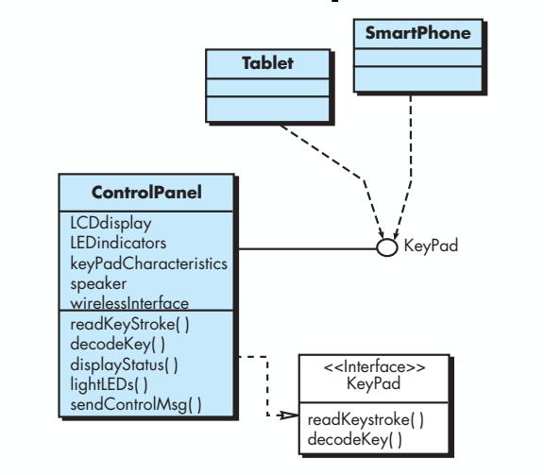
Interface-level design elements

Slide 40
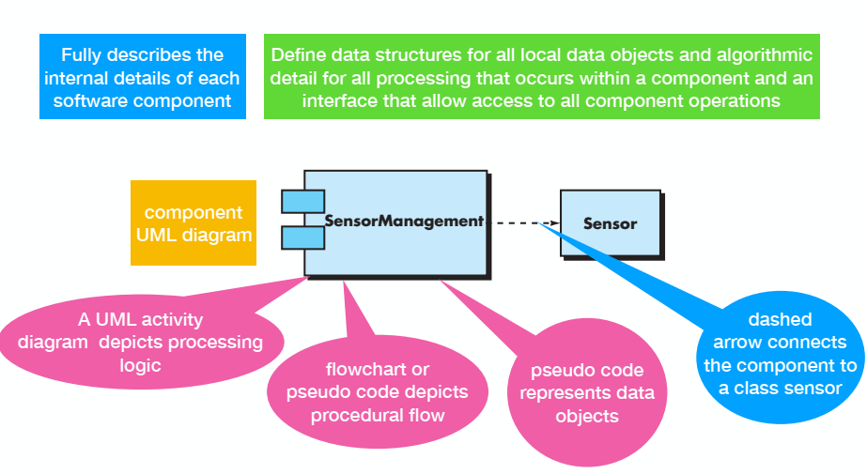
Component-level design elements

Slide 41
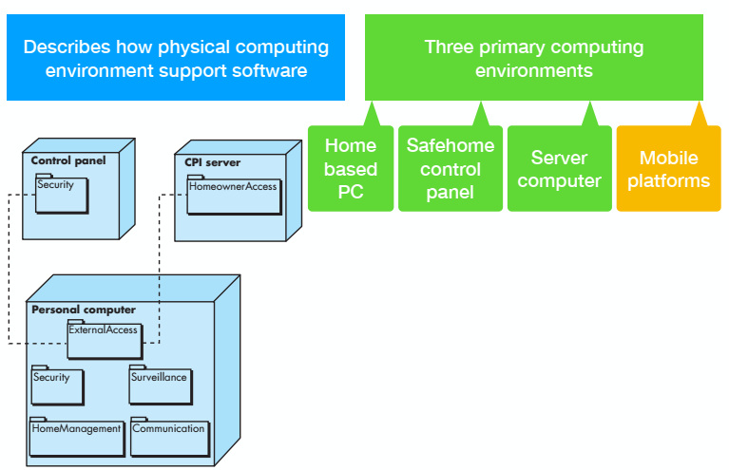
Deployment-level design elements

Slide 42


